Slide 1

BRUTE FORCE

Slide 2
Brute Force
Definition: Brute force is a straightforward approach to problem-solving that relies on directly applying the problem statement and definitions of the concepts involved.
"Just do it!": The strategy's essence is to utilize the computational power of a computer rather than relying on complex intellectual reasoning.
Simplicity: Brute force often represents the easiest and most intuitive method to apply when solving a problem.
Example: The exponentiation problem, where you need to compute a^b for a given number a and non-negative integer b, can be solved using brute force.

Slide 3
Selection Sort and Bubble Sort
The brute-force approach can also be applied to the problem of sorting, which involves rearranging a list of n orderable items in nondecreasing order.
Importance of Sorting: Sorting is a fundamental problem in computer science, and numerous algorithms have been developed to solve it efficiently.
Selection Sort: Among the two algorithms, selection sort is generally considered to be better overall and implements the brute-force approach more clearly.

Slide 4
Selection Sort
Procedure
Scan the array to find its smallest element and swap it with the first element. Then, starting with the second element, scan the elements to the right of it to find the smallest among them and swap it with the second elements. Generally, on pass i (0 ≤ i ≤ n-2), find the smallest element in A[i..n-1] and swap it with A[i]:
A[0] ≤ . . . ≤ A[i-1] | A[i], . . . , A[min], . . ., A[n-1]

Slide 5
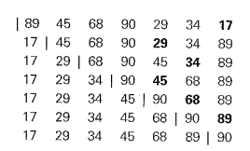
Selection Sort Analysis with example

Slide 6


Selection Sort Algorithm
ALGORITHM Selection Sort(A[0 .. n-1])
// Sorts a given array using selection sort
// Input: An array A[0 .. n-1] of orderable elements
// Output: Array A[0 .. n-1] sorted in ascending order
for i ← 0 to n-2 do
min ← i
for j ← i+1 to n-1 do
if A[j] < A[min]
min ← j
swap A[i] and A[min]
Key operation: Comparison & Swap
Let C(n) denote total Number of Comparisons
Total Number of Swaps: n – 1

Slide 7
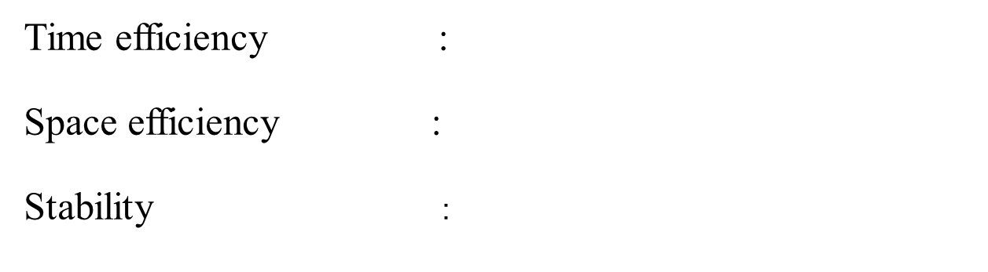
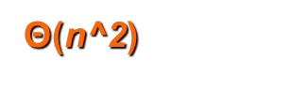

Time and Space Complexity
No

Slide 8

Bubble Sort
Another brute-force application to the sorting problem is to compare of the list and exchange them if they are out of order. By doing it repeatedly, we end up “bubbling up” the largest element to the last position on the list. The next pass bubbles up the second largest element, and so on, until after n−1 passes the list is sorted. Pass i(0≤i≤n−2)of bubble sort.
A0,...,Aj?↔Aj+1,...,An−i−1|An−i≤...≤An−1

Slide 9
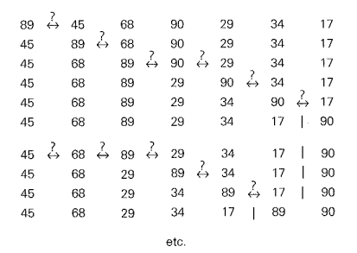
Bubble Sort Example

Slide 10

Bubble Sort Algorithm
//Sorts a given array by bubble sort in their final positions
//Input: An array A[0 .. n- 1] of orderable elements
//Output: Array A[0 .. n- 1] sorted in ascending order
BubbleSort(A[0 .. n - 1])
for i <-- 0 to n - 2 do
for j <-- 0 to n - 2 - i do
if A[j + 1] < A[j] then
swap A[j] and A[j + 1]

Slide 11
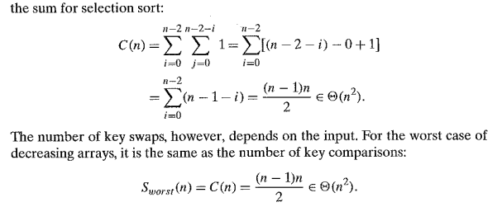
Bubble Sort Analysis

Slide 12
Stable and Unstable Sorting Algorithm

Slide 13
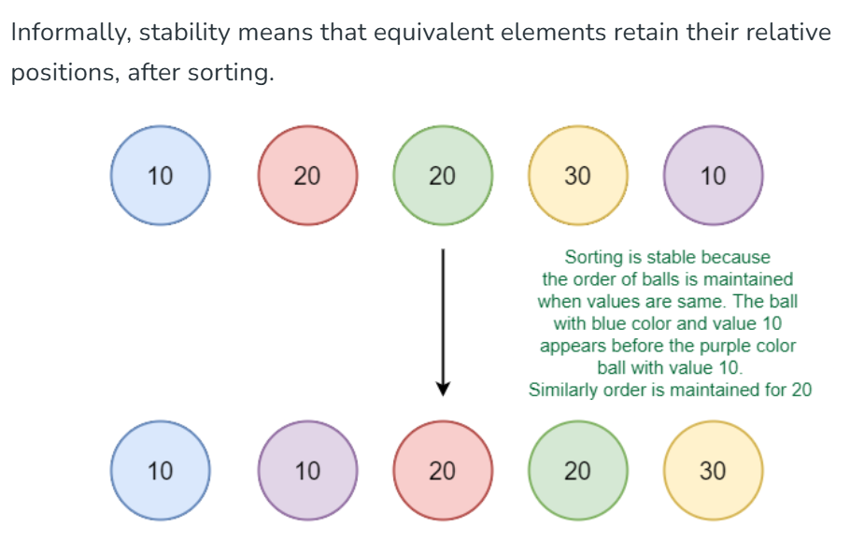
A sorting algorithm is said to be stable if two objects with equal keys appear in the same order in sorted output as they appear in the input data set.
Soucre: Stable and Unstable Sorting Algorithms - GeeksforGeeks

Slide 14
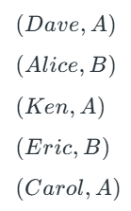
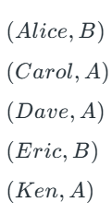
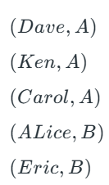
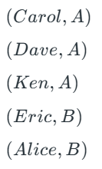
Consider the following dataset of Student Names and their respective class sections.
Sort according to Name. Resulting data is not grouped according to section
Sort again section wise. This will sort according section but not according to name
In the name-sorted dataset, the tuple (Alice, B) was before (Eric, B) , but since the sorting algorithm is not stable, the relative order is lost. If on the other hand, we used a stable sorting algorithm, the result would be:

Slide 15
Stable sorting algorithms: Bubble sort, Insertion sort, Merge sort, counting (rank sort)
Unstable sorting algorithms: Selection sort, Quick sort and Heap sort.
In general, any comparison-based sorting algorithm which is not stable by nature can be modified to be stable by changing the key comparison operation so that the comparison of two keys considers position as a factor for objects with equal keys. Selection sort can be modified as stable
When equal elements are indistinguishable, such as with integers, or more generally, any data where the entire element is the key, stability is not an issue. Stability is also not an issue if all keys are different.

Slide 16

Sequential Search
//Implements sequential search with a search key as a sentinel
//Input: An array A of n elements and a search key K
//Output: The index of the first element in A[O .. n -1) whose value is II equal to K or -1 if no such element is found
SequentialSearch(A[0..n], K)
A[n] <- K
i <- 0
while A[i] != K do
i <- i + 1
if i < n then
return i
else
return –1
Time Complexity ---- ???

Slide 17

String Matching
The string-matching problem involves finding a substring in a given text that matches a given pattern.
Example : Nobody noticed him
In this example, the text is "Nobody noticed him" and the pattern is not specified. We'll assume the pattern is "not" for demonstration purposes.
The goal is to find the index i of the leftmost character of the first matching substring in the text.

Slide 18

String Matching

Slide 19
String Matching
The algorithm starts by comparing the first character of the pattern with the characters in the text starting from the first character.
If there is a match, it continues to compare the next characters of the pattern with the consecutive characters in the text.
If there is a mismatch at any point, the algorithm moves to the next character in the text and starts comparing again from there.
In our example, the algorithm would compare "not" with the first three characters of the text - "Nob". It would find a mismatch and move to the next character.
The algorithm continues this process until either a complete match is found or the end of the text is reached.
If a match is found, the algorithm returns the index i of the leftmost character of the matching substring.

Slide 20
String Matching Algo
ALGORITHM Brute Force String Match(T[0..n−1],P[0..m−1])
//Implements brute-force string matching
//Input: An array T[0..n−1] of n characters representing a text and
//an array P[0..m−1] of m characters representing a pattern
//Output: The index of the first character in the text that starts a matching substring or−1 if the search is unsuccessful for
for i←0 to n−m do
j←0
While j<m and P[j]=T[i+j] do
j←j+1
if j=m return i
return−1

Slide 21
String Matching Time Complexity
In the worst case scenario, the algorithm may have to make all m comparisons before shifting the pattern.
This worst case can happen for each of the n - m + 1 tries, where n is the length of the text and m is the length of the pattern.
So, in the worst case, the time complexity of the algorithm is O(n * m), which means it grows proportionally to the product of the lengths of the text and the pattern.
However, for a typical word search in a natural language text, most shifts happen after very few comparisons.
This means that in practice, the average-case efficiency of the algorithm is considerably better than the worst-case efficiency.
In fact, for searching in random texts, it has been shown that the average-case time complexity is linear, meaning it grows linearly with the sum of the lengths of the text and the pattern. So it is O(n + m).
This linear time complexity, O(n + m), is much more efficient than the worst-case time complexity, O(n * m).
It's important to note that these time complexities are specific to the algorithm being used. Different string-matching algorithms may have different time complexities and performance characteristics.

Slide 22
Exhaustive search
Exhaustive search is a method in which solution is obtained by searching each element of given problem.
Exhaustive search is a brute force method for combinatorial optimization problems.
Travelling salesman problem
Knapsack problem
Assignment problem

Slide 23

Traveling Salesman Problem (TSP)
The TSP involves finding the shortest possible route that a salesman can take to visit a set of cities and return to the starting city, while visiting each city exactly once.
The cities and their connections are represented as a weighted graph, where the weights along the edges represent the distances or costs between the cities. The goal is to find the route with the minimum total weight.

Slide 24
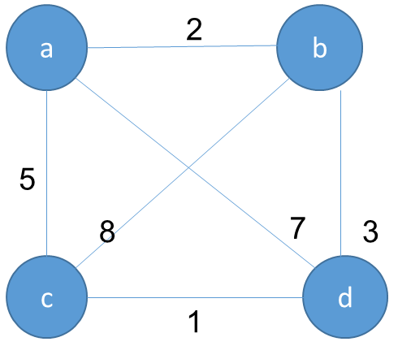
TSP PROBLEM

Slide 25

TSP - SOLUTION
Tour | Length | Solution
a-b-c-d-a | 2+8+1+7=18
a-b-d-c-a | 2+3+1+5=11 | Optimal solution
a-c-b-d-a | 5+8+3+7=23
a-c-d-b-a | 5+1+3+2=11 | Optimal solution
a-d-b-c-a | 7+3+8+5=23
a-d-c-b-a | 7+1+8+2=18

Slide 26
KNAPSACK PROBLEM
The Knapsack Problem involves selecting a subset of items from a given set, where each item has a weight and a benefit value. The goal is to maximize the total benefit value of the selected items while ensuring that the total weight does not exceed the knapsack's maximum capacity.
The problem can be formulated as an optimization problem, where the decision variables represent whether an item is included in the knapsack or not. Different algorithms, such as dynamic programming or greedy algorithms, can be used to solve the Knapsack Problem and find the optimal solution.

Slide 27
KNAPSACK PROBLEM
Item i | Weight W_{i} | Value V_{i}
1 | 2 | $1
2 | 3 | $2
3 | 4 | $8
4 | 5 | $6
The capacity of the Knapsack = 8

Slide 28

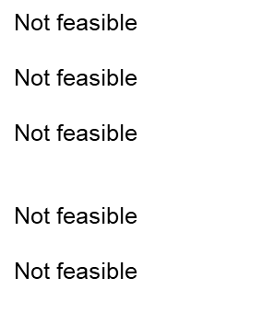
KNAPSACK SOLUTION
Item i | Weight W_{i} | Value V_{i}
Item 1 | ∑w_{i}=2 | ∑V_{i}=$1
Item 2 | ∑w_{i}=3 | ∑V_{i}=$2
Item 3 | ∑w_{i}=4 | ∑V_{i}=$8
Item 4 | ∑w_{i}=5 | ∑V_{i}=$6
Item 1,2 | ∑w_{i}=2+3=5 | ∑V_{i}=1+2=$3
Item 1,3 | ∑w_{i}=2+4=6 | ∑V_{i}=1+8=$9
Item 1,4 | ∑w_{i}=2+5=7 | ∑V_{i}=1+6=$7
Item 2,3 | ∑w_{i}=3+4=7 | ∑V_{i}=2+8=$10
Item 2,4 | ∑w_{i}=3+5=8 | ∑V_{i}=2+6=$8
Item 3,4 | ∑w_{i}=4+5=9 | ∑V_{i}=8+6=$14
Item 1,2,3 | ∑w_{i}=2+3+4=9 | ∑V_{i}=1+2+8=$11
Item 1,2,4 | ∑w_{i}=2+3+5=10 | ∑V_{i}=1+2+6=$9
Item 2,3,4 | ∑w_{i}=3+4+5=12 | ∑V_{i}=2+8+6=$16
Item 1,2,3,4 | ∑w_{i}=2+3+4+5=14 | ∑V_{i}=1+2+8+6=$17

Slide 29

Assignment Problem
The Assignment Problem involves assigning n people to n jobs, with the goal of minimizing the total cost associated with the assignments. Each person can be assigned to only one job, and each job can be assigned to only one person.
The cost of assigning a particular person to a particular job is represented by the cost matrix C[i, j]. The objective is to find the assignment that results in the minimum total cost across all assignments.

Slide 30
Assignment Problem
 | Job 1 | job2 | Job 3 | job4
Person 1 | 10 | 3 | 8 | 9
Person 2 | 7 | 5 | 4 | 8
Person 3 | 6 | 9 | 2 | 9
Person 4 | 8 | 7 | 10 | 5

Slide 31
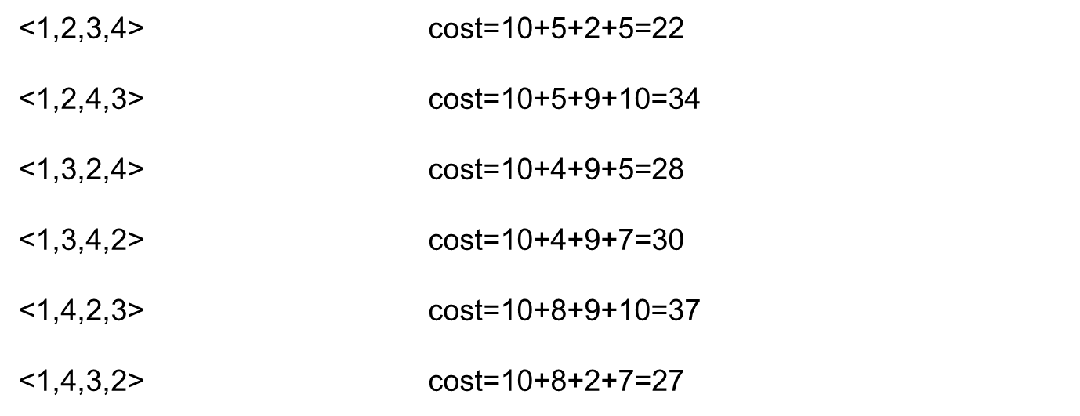
Assignment Problem- Solution

Slide 32
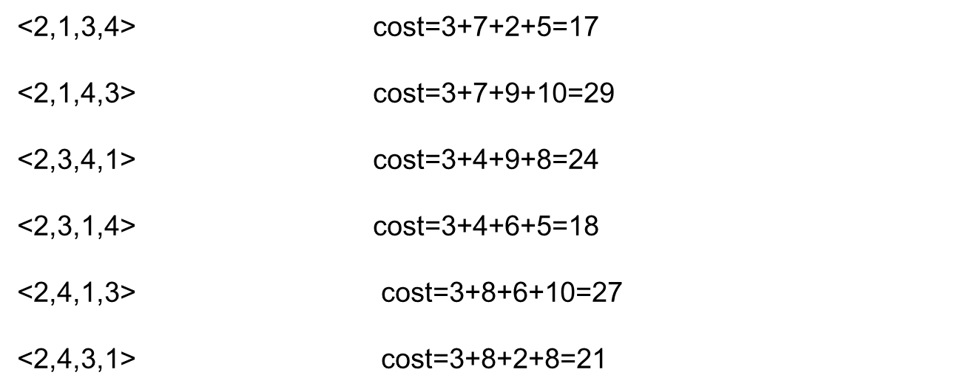
Assignment Problem- Solution

Slide 33
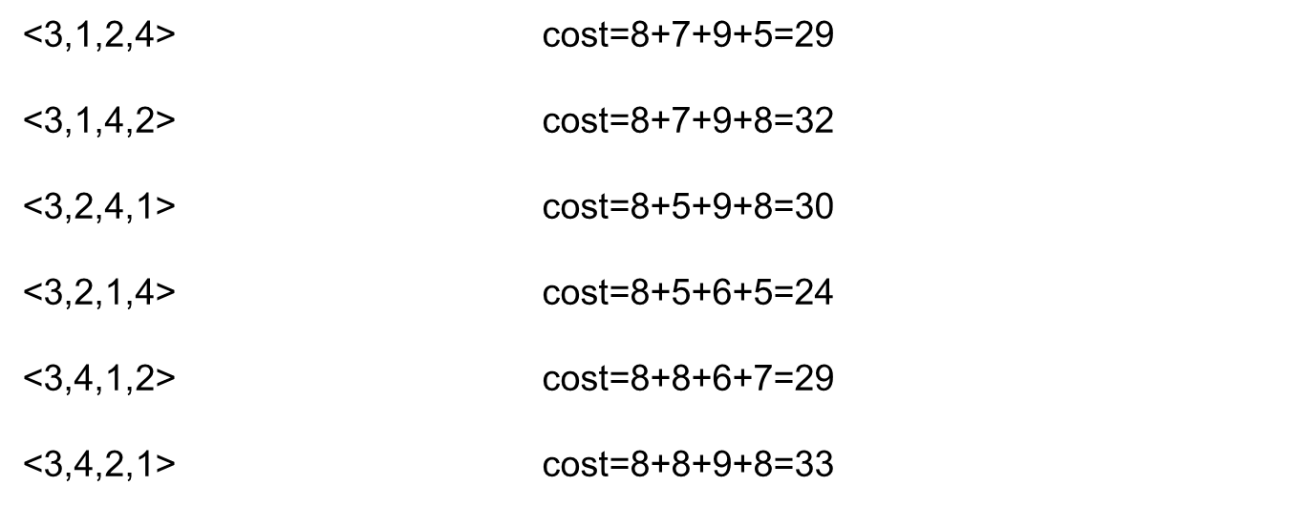
Assignment Problem- Solution

Slide 34
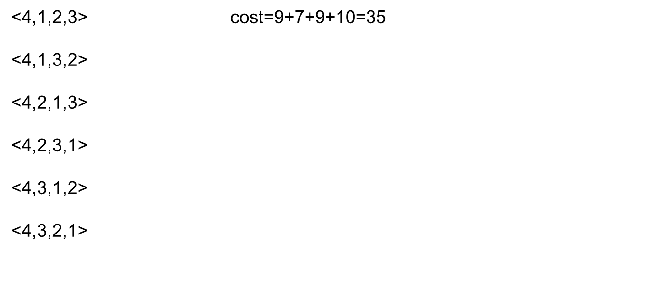
Assignment Problem- Solution

Slide 35
Assignment Problem-Analysis
Thus by trying 24 permutation(n!=4!=24),we can obtain optimum solution. The optimum solution is <2,1,3,4>i.e.cost=3+7+2+5=17.
Thus we have to generate n! instances to find solution using exhaustive search. This also shows how inefficient exhaustive search method is for solving such problems.
For solving these types of problems, many efficient algorithms are available

Slide 36
DFS & BFS
Traversal Given G=(V,E) and vertex v, find all w∈V, such that w connects v.
Depth First Search (DFS) preorder tree traversal
Breadth First Search (BFS) level order tree traversal
Applications:
To find Connected Components of a graph G
Spanning Tree : A subgraph T of G is said to be spanning tree of the graph G if T is a tree and consist all the vertices of G
Find path between two vertices in a graph

Slide 37
Breadth First Search
Method of starting at a vertex and identifying all vertices reachable from it.
Implemented using queue
2
3
8
1
4
5
9
10
6
7
11

Slide 38
Pseudocode for BFS
BFS(v)
{ Label vertex v as reached.
Initialize Q queue with only v in it
while(Q is not empty)
{
delete a vertex w from the queue;
Let u be any vertex adjacent from w;
while(u)
{
if(u has not been labeled){
Add u to queue;
label u as reached; }
u=next vertex adjacent from w;
}}

Slide 39
Breadth-First Search Example
2
3
8
1
4
5
9
10
6
7
11
Start search at vertex 1.

Slide 40
Breadth-First Search Example
2
FIFO Queue
1
3
8
1
1
4
5
9
10
6
7
11
Visit/mark/label start vertex and put in a FIFO queue.

Slide 41
Breadth-First Search Example
2
FIFO Queue
1
3
8
1
1
4
5
9
10
6
7
11
Remove 1 from Q; visit adjacent unvisited vertices;
put in Q.

Slide 42
Breadth-First Search Example
2
FIFO Queue
2
3
2
4
8
1
1
4
4
5
9
10
6
7
11
Remove 1 from Q; visit adjacent unvisited vertices;
put in Q.

Slide 43
Breadth-First Search Example
2
FIFO Queue
2
3
2
4
8
1
1
4
4
5
9
10
6
7
11
Remove 2 from Q; visit adjacent unvisited vertices;
put in Q.

Slide 44
Breadth-First Search Example
2
FIFO Queue
2
3
3
4
5
3
6
8
1
1
4
4
5
5
9
10
6
6
7
11
Remove 2 from Q; visit adjacent unvisited vertices;
put in Q.

Slide 45
Breadth-First Search Example
2
FIFO Queue
2
3
3
4
5
3
6
8
1
1
4
4
5
5
9
10
6
6
7
11
Remove 4 from Q; visit adjacent unvisited vertices;
put in Q.

Slide 46
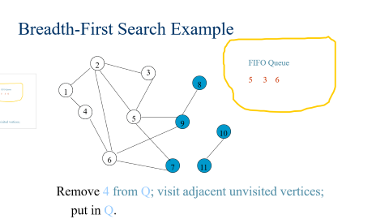
Breadth-First Search Example
2
FIFO Queue
2
3
3
5
3
6
8
1
1
4
4
5
5
9
10
6
6
7
11
Remove 4 from Q; visit adjacent unvisited vertices;
put in Q.

Slide 47
Breadth-First Search Example
2
FIFO Queue
2
3
3
5
3
6
8
1
1
4
4
5
5
9
10
6
6
7
11
Remove 5 from Q; visit adjacent unvisited vertices;
put in Q.

Slide 48
Breadth-First Search Example
2
FIFO Queue
2
3
3
3
6
9
7
8
1
1
4
4
5
5
9
9
10
6
6
7
7
11
Remove 5 from Q; visit adjacent unvisited vertices;
put in Q.

Slide 49
Breadth-First Search Example
2
FIFO Queue
2
3
3
3
6
9
7
8
1
1
4
4
5
5
9
9
10
6
6
7
7
11
Remove 3 from Q; visit adjacent unvisited vertices;
put in Q.

Slide 50
Breadth-First Search Example
2
FIFO Queue
2
3
3
6
9
7
8
1
1
4
4
5
5
9
9
10
6
6
7
7
11
Remove 3 from Q; visit adjacent unvisited vertices;
put in Q.

Slide 51
Breadth-First Search Example
2
FIFO Queue
2
3
3
6
9
7
8
1
1
4
4
5
5
9
9
10
6
6
7
7
11
Remove 6 from Q; visit adjacent unvisited vertices;
put in Q.

Slide 52
Breadth-First Search Example
2
FIFO Queue
2
3
3
9
7
8
1
1
4
4
5
5
9
9
10
6
6
7
7
11
Remove 6 from Q; visit adjacent unvisited vertices;
put in Q.

Slide 53
Breadth-First Search Example
2
FIFO Queue
2
3
3
9
7
8
1
1
4
4
5
5
9
9
10
6
6
7
7
11
Remove 9 from Q; visit adjacent unvisited vertices;
put in Q.

Slide 54
Breadth-First Search Example
2
FIFO Queue
2
3
3
7
8
8
8
1
1
4
4
5
5
9
9
10
6
6
7
7
11
Remove 9 from Q; visit adjacent unvisited vertices;
put in Q.

Slide 55
Breadth-First Search Example
2
FIFO Queue
2
3
3
7
8
8
8
1
1
4
4
5
5
9
9
10
6
6
7
7
11
Remove 7 from Q; visit adjacent unvisited vertices;
put in Q.

Slide 56
Breadth-First Search Example
2
FIFO Queue
2
3
3
8
8
8
1
1
4
4
5
5
9
9
10
6
6
7
7
11
Remove 7 from Q; visit adjacent unvisited vertices;
put in Q.

Slide 57
Breadth-First Search Example
2
FIFO Queue
2
3
3
8
8
8
1
1
4
4
5
5
9
9
10
6
6
7
7
11
Remove 8 from Q; visit adjacent unvisited vertices;
put in Q.

Slide 58
Breadth-First Search Example
2
FIFO Queue
2
3
3
8
8
1
1
4
4
5
5
9
9
10
6
6
7
7
11
Queue is empty. Search terminates.

Slide 59
Pseudocode for BFS
BFS(v)
{ Label vertex v as reached.
Initialize Q queue with only v in it
while(Q is not empty)
{
delete a vertex w from the queue;
Let u be any vertex adjacent from w;
while(u)
{
if(u has not been labeled){
Add u to queue;
label u as reached; }
u=next vertex adjacent from w;
}}

Slide 60
BFS(v)
{ Label vertex v as reached. -------- O(1)
Initialize Q queue with only v in it -------- O(1)
while(Q is not empty) -------- O(n)
{
delete a vertex w from the queue; -------- O(n)
Let u be any vertex adjacent from w;
while(u)
{
if(u has not been labeled){
Add u to queue;
label u as reached; }
u=next vertex adjacent from w;
}
}}
For adjacency matrix representation of the graph then O(n) time. Total steps O(n²)
For adjacency list representation O(degree(w)). Total steps O(n + e)
Time Complexity of BFS: O (n + e), where n = |V| and e = |E|

Slide 61
Applications of BFS
•Breadth-first search can be used to solve many problems such as:
•Finding all connected components in a graph G.
•Finding all nodes within an individual connected component.
•Finding the shortest path between two nodes, u and v, of an unweighted graph.

Slide 62
DFS Algorithm
DFS (v)
{
Label v as visited; O(n)
for each verted w adjacent from v
{
if (w is not visited)
DFS(w);
}
}
For adjacency matrix representation of the graph then O(n) time. Total steps O(n²)
For adjacency list representation O(degree(w)). Total steps O(n + e)

Slide 63
Depth-First Search Example
2
Start search at vertex 1.
Trace the DFS algorithm
3
8
1
4
5
9
10
6
7
11

Slide 64
Applications of DFS
•Finding a path between two specified nodes, u and v, of an unweighted graph.
•Finding a path between two specified nodes, u and v, of a weighted graph.
•Finding whether a graph is connected or not.
•Computing the spanning tree of a connected graph.

Slide 65
Time complexity wise both DFS and BFS takes O(n+e) time. Space complexity wise best and worst case for dfs and bfs has given in the above figure (a) and (b).

